Slide 1

Solar Energy Production Zone Clustering
Rahul Thakur

Slide 2
AGENDA
01 Introduction
02 Data Collection
03 Preprocessing
04 Methodology
05 Model Evaluation
06 Conclusion

Slide 3
Introduction
Solar energy production zone clustering involves categorizing geographical regions based on solar energy production capacity, resource availability, and infrastructure. By analyzing key factors like system size, energy output, and grid connections, zones with similar characteristics are grouped together.
The primary objectives of clustering include strategic targeting, improving project feasibility, optimizing energy distribution, and enhancing resource management. By identifying distinct zones, stakeholders can make informed decisions to prioritize investments, streamline operations, and maximize solar energy production in specific areas.
Key factors in clustering include estimated system size, actual production output, geographical location, grid infrastructure, and energy storage capacity. These factors help define the energy potential of each zone and provide insights into how different areas can be optimized for solar power generation.

Slide 4
Workflow
01 Data Collection
02 Preprocessing
03 EDA
04 Modelling
05 Model Evaluation

Slide 5

Data
The dataset captures key details about solar energy projects, including their geographic locations, system sizes, and production capacities. It contains features like: 1. PV System Size (kWac), representing the actual size of each solar power project. 2. Estimated Annual PV Energy Production (kWh), which provides a projection of the energy output. Interconnection Date tracks when each project was connected to the grid. 3. Utility denotes the organization managing the power grid in that region. 4. Energy Storage System Size (kWac), indicating the energy storage capacity, and Developer, identifying the organization responsible for each project. This data provides insights into the distribution of solar energy production and helps inform decisions regarding infrastructure and resource management.

Slide 6
Preprocessing
Columns like Data Through Date, Project ID, Circuit ID, Developer, Energy Storage System Size (kWac), Number of Projects were dropped as they were either irrelevant or had too many missing values that couldn't be reliably imputed.
Handling Missing Values:
The dataset contained missing values in key columns:.
Division and Substation had 85000 and 80000 missing values, which were filled using the most frequent value within the same 'Zip'
For Zip and City/Town values, any missing entries were filled based on geographic proximity or inferred using neighboring values where applicable to preserve spatial integrity.
Feature Scaling:
MinMax scaling was applied to standardize the dataset. This method was chosen after comparing the results of different scaling techniques, such as MinMax and Standard scaling. MinMax scaling produced better clustering performance and helped normalize features like PV System Size and Energy Production without distorting relative distances in the data.
Encoding Categorical Variables:
Categorical columns such as City/Town, County, Substation, and Zip were label-encoded to convert them into numerical format. This allowed these categorical features to be used in the clustering process effectively. I had to use Label Encoding because they had high cardinality
Features that had low cardinality like Utility and Metering Method were one hot encoded.
Division still had over 82,000 missing values. This column was dropped due to its high percentage of missing values
Substation missing values reduced to 147, for which I removed the rows that had this feature missing.

Slide 7
Model Selection
K-Means Clustering: Partitions data into K clusters by minimizing the sum of squared distances within each cluster. It’s a simple, iterative algorithm often used for its speed and efficiency.
Gaussian Mixture: Models data as a mixture of Gaussian distributions, allowing soft clustering. Uses tied covariance where all components share a matrix. Other covariance types include full, diagonal, and spherical for flexibility.
DBSCAN: Groups densely packed points into clusters while identifying noise as outliers. It’s non-parametric, doesn’t require specifying the number of clusters, and is effective in detecting clusters of varying shapes and sizes.

Slide 8
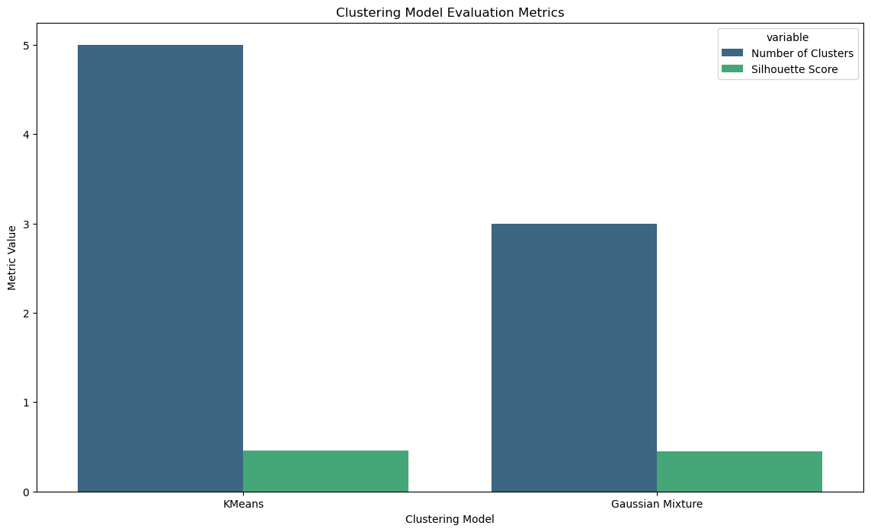
Model Evaluation
I have used silhouette score to evaluate the model.
Since the dataset was huge, my systems capacity was at par and I couldn’t use other metrics like Calinski-Harabasz Index or Davies Bouldin Score.

Slide 9
Conclusion
The solar energy production zone clustering project successfully identified distinct geographical zones based on solar energy production capacities, infrastructure, and other critical factors. By analyzing features such as system size, energy output, grid connections, and energy storage, the clustering model provided insights into areas that could be targeted for future solar energy investments or improvements.
The project demonstrated the value of data-driven decision-making in optimizing energy distribution and resource management. These clusters allow stakeholders to make more informed decisions, prioritize regions with high production potential, and address areas requiring infrastructure development. Furthermore, it highlighted how various factors—such as geographic location, grid infrastructure, and system capacity—play a significant role in determining the energy efficiency of different zones.
Looking ahead, future work could involve integrating real-time energy production data, exploring more granular levels of geographical segmentation, or expanding the model to incorporate environmental factors like solar irradiance or weather patterns. Additionally, the project could be enhanced by incorporating predictive models to forecast solar energy production trends and demand in the clustered regions.

Slide 10
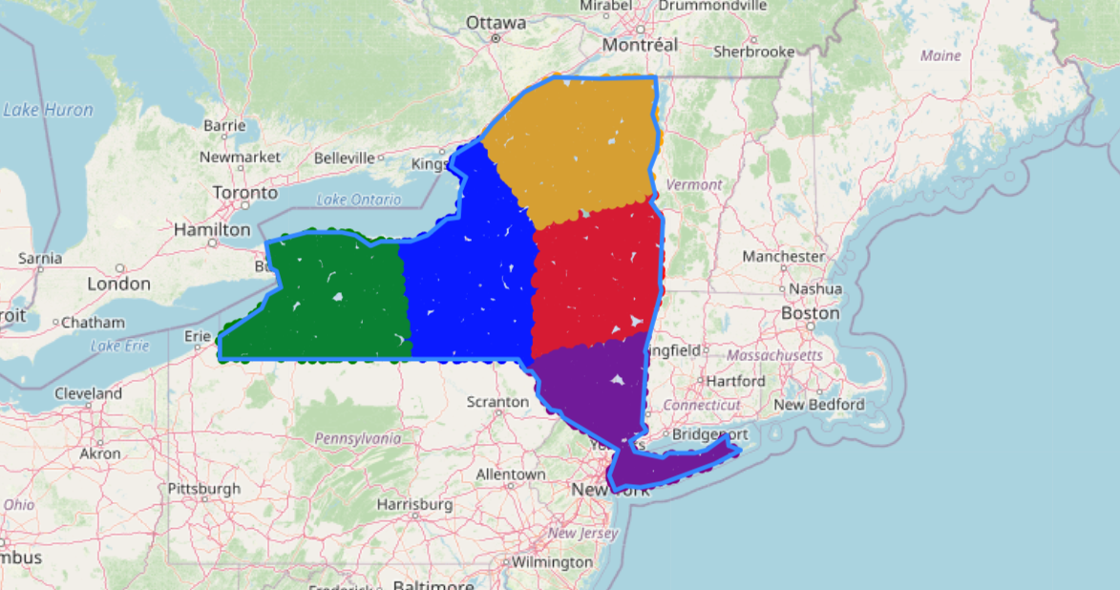
Geoclustering based on the annual solar energy production
Cluster 2
Cluster 4
Cluster 0
Cluster 1
Cluster 3

Slide 11
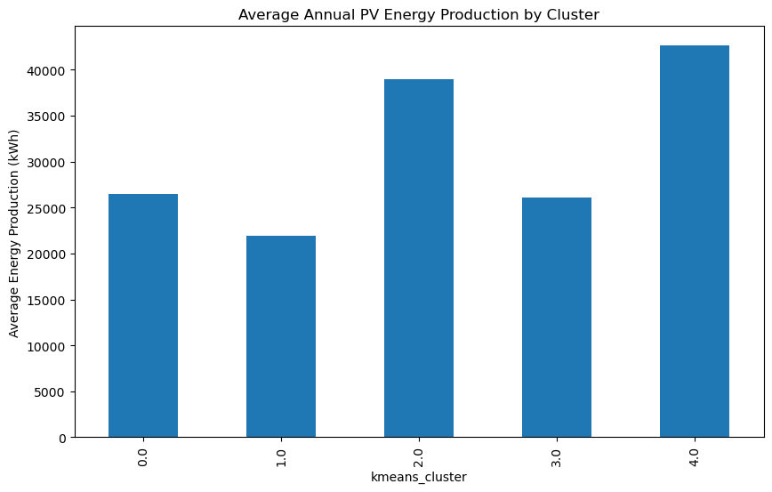
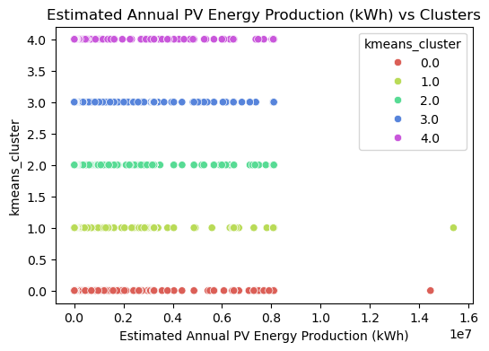
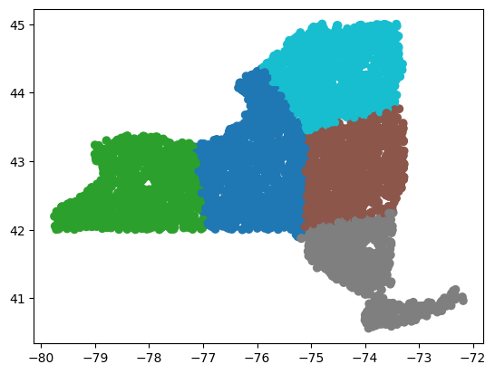
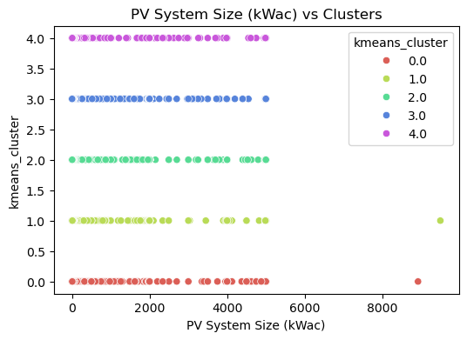
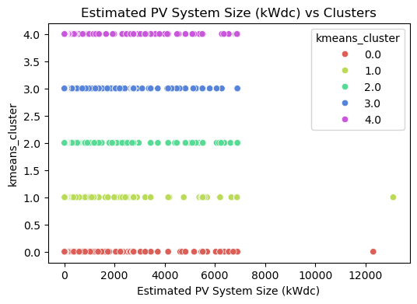
Cluster Analysis
Cluster 0 (Red): Small-scale, likely residential or very small commercial projects with low PV system sizes and energy production.
Cluster 1 (Green): Moderate-sized projects, likely small-to-medium commercial or community solar installations.
Cluster 2 (Blue): Large commercial installations with significant energy production.
Cluster 3 (Purple): Utility-scale solar farms with the highest PV system sizes and energy output.
Cluster 4 (Orange): Mid-to-high capacity projects, positioned between large commercial and utility-scale installations.
Each cluster shows a clear progression in the size and energy production capacity of the solar projects, from small residential systems to large utility-scale solar farms.

